Slide 1
Build, Iterate, and Debug Prototypes End-to-End
Module 4
Notes:
Module 4: Build, Iterate, and Debug Prototypes End-to-End

Slide 2

Class Expectations
Cameras On
Be present and visible with your camera on to stay engaged in class.
Arrive On Time
Respect everyone’s time by arriving promptly to sessions.
Active Engagement
During exercises and labs, participate actively in all discussions and activities.
📹
⏰
✋
Network
During class, connect with peers and build your learning network.
Use Slack
Use Slack for all communication to keep questions and comments organized.
Instructor Support
Save deeper questions for after class with your instructor so as to not stop class flow.
🌐
🎓
Notes:
Notes
📌Note for instructors: Please do not share the link to the slide deck with students. If they want to view the deck, send them to the LMS where they can view it from there.
Where to access content? You can view the deck from Docebo.
ℹ️ All students should have access to the LMS (Docebo) with all the class materials by now. If not, please reach out to Student Success directly in Slack.

Slide 3
AI Prototyping Certification Syllabus
Accelerate the Idea-to-Validation Cycle
Shift from static specs to interactive prototypes that win alignment fast. Learn why AI prototyping is a critical PM skill reshaping the role, and experience firsthand how to turn ideas into prototypes in minutes.
Write Advanced Prompts for High-Fidelity Prototypes
Master prompting as a core execution skill for the modern PM. Move beyond simple commands to learn the advanced, structured techniques that generate functional, high-fidelity results.
Define the Modern Specs for Prototype Development
Master the new approach to requirements with the one-page prototype spec. Learn to transform your prototype into a clear, actionable document that drives team alignment and accelerates development.
MODULE 1
MODULE 2
MODULE 3
Build, Iterate, and Debug Prototypes End-to-End
Translate specs into working prototypes and test in real time. Use AI as a co-pilot to debug quickly, reduce risks, and ensure your builds are resilient, scalable, and ready to evolve.
Power Advanced Prototypes With API Integrations
Take your prototype to the next level by incorporating advanced, secure integrations. Learn the workflow design for connecting to live APIs while ensuring compliance, scalability, and stability.
Deploy and Scale Prototypes Into Production
Master the fastest path from a working prototype to production. Learn to manage the final deployment and handoff, leveraging rapid iteration to save significant engineering time and cost.
MODULE 4
MODULE 5
MODULE 6
Notes:
AI Prototyping Certification Syllabus
Build, test, and ship interactive AI prototypes that turn ideas into working products in record time.

Slide 4
Agenda
01 Managing Your Build Like a PM
02 Hands-On Labs: Iteratively Extend Your Prototype Build
03 Debugging as De-Risking
03 Hands-On Lab: Link and Debug Your Prototype Screens
Notes:
Agenda
Managing Your Build Like a PM
Hands-On Labs: Iteratively Extend Your Prototype Build
Debugging as De-Risking
Hands-On Labs: Link and Debug Your Prototype Screens

Slide 5
Managing Your Build Like a PM
Notes:
01. Managing Your Build Like a PM

Slide 6

Instructor-Led Q&A
Let's discuss the next phase of prototyping:
Based on the full user flow defined in the Simplified PRD, what is the next screen you must build to complete the core user journey?
Now, think about your group’s fitness prototype:
Referring back to your Simplified PRD, you (likely) have one or two screens built. What is the next feature or screen you need to build and link to the existing components to complete your primary prototype vision?
Q&A DISCUSSION
10 minutes
What Would You BUILD Next?
Think back to the Airbnb Snap Wishlist prototype screen you built last class.
You successfully built a clear feature where users upload a photo and see matching listings.
You used the Simplified PRD to define the complete user journey, but you likely only built the first one or two screens of that journey.
Notes:
Notes
💥Activity: Instructor-Led Q&A
💬Topic: What Would You BUILD Next?
⏱️Time: 10 Minutes
📌 Note for Instructors: Remind the students that, so far in this course, they’ve focused on creating one or two pieces of their prototype (the goal setting screen ). Now, we transition to Module 4: Execution—the process of building additional pieces and linking them together. Crucially, remind them that their own Fitness App PRDs (built at the end of M3) define the full flow they are now responsible for building. The questions below transition from the Airbnb case to their own required next step.
Instructions: Think back to the Airbnb Snap Wishlist prototype. You successfully built a clear feature where users upload a photo and see matching listings. You used the example Simplified PRD to define the complete user journey, but you likely only built the first one or two screens of that journey. Now, we need to talk about building the rest of the flow and linking it up. Discuss the following:
Questions:
Based on the full user flow defined in the Simplified PRD, what is the next screen you must build to complete the core user journey?
Possible answers: The Save/Wishlist Screen' or 'The Detailed Listing View'
Referring back to your Simplified PRD, you (likely) have one or two screens built. What is the next feature or screen you need to build and link to the existing components to complete your primary prototype vision?
Let students know these answers should becomes the focus of their work in the upcoming lab session.

Slide 7

The Rules of Enforcement
From Blueprint to Build
You have your prompt pack and your requirements defined. Now, your focus shifts from definition to enforcement.
🧩 Build feature-by-feature with modular execution.
🧪 Test logic immediately with validation loops.
🛤️ Link features seamlessly into a unified flow.
IN A NUTSHELL: Great specs provide the signal. Your job is to manage the noise during execution.
Notes:
Notes
In Module 3, you acted as the Architect—you defined the specs and the prompt pack with your Simplified PRD. Now, your focus shifts. You are moving from definition to enforcement.
You’ve learned the individual pieces—how to prompt, how to spec, and how to use the tools. Now, we’re putting it all together.
The goal here is to make prototyping a repeatable process so you aren't just generating single screens, but building a robust, functional V1 that you can actually share with stakeholders to win buy-in. That requires a shift in how you build:
Modular Execution: This is about control. For example, if the goal setting screen in your fitness app breaks, you don’t re-prompt the entire app and hope for the best. You isolate that specific component, fix it, and reconnect it. That is how you scale without breaking what already works.
Validation Loops: Don't wait until the end to test. Verify the logic of each feature immediately so you aren't building on top of broken code.
Functional Integration: Stop thinking in separate screens or pieces. Your job is to link your prototype features into the seamless flow you defined in your Simplified PRD—specifically executing the happy path journey you mapped out in your User Flow requirements.
In a nutshell: Your specs provide the signal. Your job now is to manage the noise to get it built. So, let’s get into the architecture tips you need to manage that build effectively.

Slide 8
Managing Your Prototype’s Memory During Build
Component Naming Protocol
State Naming Protocol
Referencing Protocol
"Generate a reusable component called {WorkoutCard}"
"Store the user's selection in a variable called {User_Goal}"
√“Use the {WorkoutCard} component and filter it based on the {User_Goal} variable.”
Always define a specific, reusable name for every component you generate.
Without a name, the AI cannot reuse the object, leading to style drift and inconsistent designs across your prototype.
When asking the AI to remember a choice, label the memory slot where that data is stored.
If the memory isn't labeled, the app "forgets" the user's input the moment they navigate to the next screen.
To connect screens or recall data, use the exact name defined in the previous steps
Without it, the AI fails to link the new screen to the existing data, resulting in broken links or generic, unfiltered views.
Notes:
Notes
We just established the rule: your job is to shift from definition to enforcement. But to enforce structure, you have to speak the AI's language and while may be an expert at writing good prompts, this is about building the system architecture.
Keep in mind the following protocols as you build out your screens for your prototype:
Component Naming Protocol: This is the difference between generating a good button and generating a reusable button. You must give every component a specific name, like {WorkoutCard}. This is an architectural command that tells the AI to create a reusable building block. If you skip this, you get style drift.
State Naming Protocol: You need to move beyond simple language like 'remember.' You command the AI to label a memory slot, like {User_Goal}. This enforces a persistent user session, ensuring the app doesn't forget user input.
Referencing Protocol: This is your final enforcement command. You use those exact, defined names to command the connection. You tell the AI: 'Use the {WorkoutCard} and filter it based on the {User_Goal}.' You are creating the wireframe for your logic.
Mastering these three protocols ensures your prototype build is scalable, consistent, and ready for validation.

Slide 9

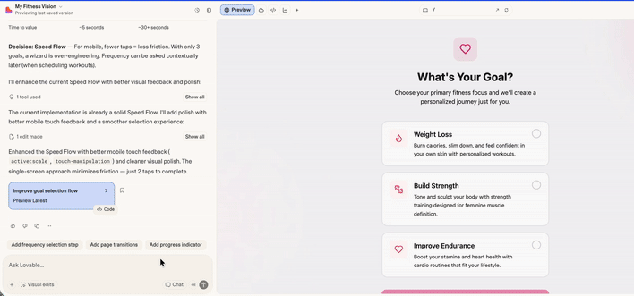
Optimize Speed and Cost by Switching Gears
Advanced Build Tactic #1
Master the Mode Matrix
Chat Mode: Best for visual iteration (vague/global changes) "Make the shadows softer." "Try a high-contrast theme." "Make the cards look like Airbnb."
Agent/Builder Mode: Best for logic and structure (functional changes) "Create a new 'Dashboard' component." "Filter this list by date." "Connect the 'Next' button."
Most beginners stay in high-cost "Builder Mode" for everything. Learn to downgrade your mode to save credits.
Notes:
Notes
So, we’ve established the rules of enforcement—that's your strategy. Now, let’s look at the tactical controls you have in the tool to actually execute that strategy. Let’s cover three specific advanced tactics to help you build faster and smarter.
Tactic 1: Mastering Mode Matrix
A common rookie mistake is staying in the default 'Builder Agent' mode for absolutely everything. It’s powerful, but it is slow and burns through your credits rapidly (as some of you have seen!) Think of this like managing a team. You wouldn't hire a structural engineer to paint a wall.
If you just need to polish the UI, change a color, or rewrite some copy, switch to Chat Mode. It is fast and low-cost.
Save the Builder Mode for when you need high-reasoning tasks—like creating new components, connecting screens, or writing complex logic.
Knowing when to switch gears is the easiest way to double your prototyping runway.

Slide 10

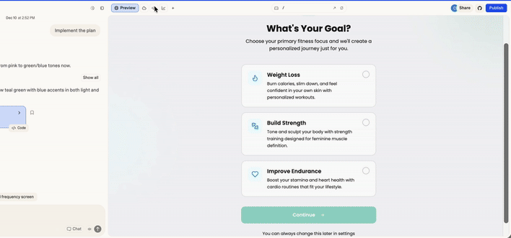
Surgical Edits for Precision Control
Advanced Build Tactic #2
The “Glass Box” Rule
Manual Injection: If you know exactly what you want, do not prompt. Open the code panel and surgical change things like: Exact Copy: Changing "Submit" button copy to "Let’s Go!
Brand Compliance: Pasting a specific Hex Code (e.g., #FF5A5F).
Micro-Spacing: Changing p-4 to p-6 when the AI just won't get it right. The payoff? Zero credit usage, zero risk of logic regression.
Prompting an AI to fix a typo is dangerous. It often rewrites the entire component, potentially breaking your logic just to fix a spelling error.
Notes:
Notes
But we know AI can be finicky, and you want more control.
Tactic 2: The “Glass Box” Rule
For that, you need to know when to dig into the code. Many PMs treat the AI like a 'Black Box'—they are afraid to look inside. But relying on prompts for everything is actually a risk. We call this 'Prompt Drift,’ or as you saw in earlier modules “Rage Prompting” to get results.
If you ask the AI to 'Change the button text to Submit,' it seems simple. But the AI might decide to rewrite the entire component to do it, and in the process, it could accidentally disconnect your logic or break something you just finished fixing.
So, the rule is simple: If you can type it, don't prompt it.
If you need to swap a Hex code for your brand color, or fix a typo in a header, open the code panel. Find the string. Change it manually.
It takes five seconds, costs zero credits, and most importantly, it guarantees zero regression in your logic.

Slide 11

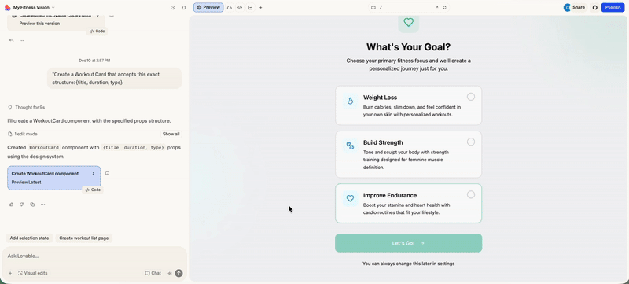
Build "Smart" Components that Scale
Advanced Build Tactic #3
Enforce Data Structures
AI defaults to painting pictures. If you ask for a "Workout Card," it writes the text "Leg Day" directly into the code as a one off that cannot be easily duplicated.
Define the Contract: Force the AI to build a template that accepts variables to separate the design from the content.
Instead of: "Make a workout card for Leg Day"
Prompt: "Create a 'Workout Card' component that dynamically accepts {Title}, {Duration}, and {Type}. Then, use that component to generate a list of 5 different workouts." You can now generate 50 identical cards in seconds just by providing a list of names because they use the same underlying code structure.
Notes:
Notes
Finally, you need to learn to build smart components that scale. This is the critical difference between building a 'sketch' that you throw away and building prototypes that actually scale.
Tactic 3: Enforce Data Structures
When you ask an AI or Lovable to simply 'Make a workout card,' it defaults to painting a picture. It hardcodes the text—like 'Leg Day'—directly into the code. That’s a 'One-Off.' If you want five more cards later, you have to prompt five times, and often they each come out looking slightly different or messy.
But if you enforce a Data Contract—if you tell the AI, 'Build a template that accepts a Title, a Duration, and a Type'—you are building a reusable engine.
You can then say, 'Generate a list of 10 workouts,' and the system will instantly spin up 10 perfectly consistent cards using that same template.
This is how you move fast without breaking your design, and it sets you up perfectly for the API work coming in Module 5.

Slide 12

Scaling Your Prototype Build
Managing System Logic
New features break old code. Manage the connection, not just the creation.
Maintain Visual Continuity
👁️
"Do not generate new styles. Reuse the {WorkoutCard} component and {PrimaryButton} from the existing system to build this new page."
Style drift happens fast in prototyping. When generating new screens, require the AI to reuse your existing components so the build stays consistent.
Carry the Context
💡
Prototypes need stable state. Make the AI pass your variables forward so choices persist across screens and the flow doesn’t break.
"Explicitly pass the {User_Goal} variable to every new screen to filter the experience dynamically."
Patch Dead Ends
🩹
"Establish a full navigation circuit. Ensure the 'Back' button uses the history state and the 'Home' icon navigates to the {Dashboard_Route}”
Navigation must behave like a real app. Since AI outputs linear paths, confirm the prototype has a full loop (forward, back, and home) from every screen.
Don't just build screens; build the flow between them.
Notes:
Notes
You now have the tactics, but this isn't just about building the 'next' screen; it's about maintaining the integrity of the whole system as it expands. As your group works on building your additional screens for your fitness app in the upcoming hands-on lab, you will find that the more screens you add, the harder it is to keep them connected.
You will need to manage three system-level risks:
Visual Continuity: As you add Screen 3, 4, and 5, the AI will try to 'drift' and invent new styles. You must force it to inherit the Design System you established on Screen 1.
Context: Your prototype needs a memory. If a user sets a goal on the landing page, that data needs to be available on the Profile page three clicks later. You have to prompt for that Global State.
Navigation: Users don't just go forward. They explore. If you only build the 'Happy Path,' you trap them. You need to ensure your navigation works as a full circuit—Forward, Backward, and Home.

Slide 13





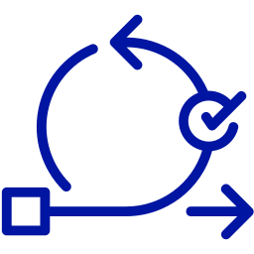
The BUILD Framework
A Repeatable Cycle for Prototyping Execution
Input: Component Cycle
Output: System Cycle
1. Break Down
4. Link
2. Unpack
5. Debug
3. Iterate
The BUILD framework: a continuous cycle
This cycle forces the structural handshake, building isolated components into a cohesive prototype.
Notes:
Notes
In Module 2, we taught you FUDI (Functionality, User Flow, Design, Interaction). FUDI is how you structure your input—it's how you write a great prompt and build your Simplified PRD requirements. BUILD is how you manage the output—it's the lifecycle of the construction. This visual is the entire execution framework for the advanced PM. This is how you take your strategy and turn it into a system.
The flow is a continuous loop with two distinct cycles:
Input: Component Cycle (*B-U-I”) → Note this is what you’ve done so far in this course!
1. Break Down: You isolate and identify a single, standalone feature from your Simplified PRD (e.g., the 'Workout Tracker Card' requirement). This keeps the scope manageable for the AI.
2. Unpack: This is the core skill. You translate the PRD details into a precise, advanced prompt. You achieve this by applying FUDI and using the framework to structure the functional and design requirements from your Simplified PRD.
Ensure you also immediately apply the memory protocols to enforce object naming. This forces the AI to build a reusable {WorkoutCard} template rather than a static image.
3. Iterate: You review the generated output against your Simplified PRD criteria, refine the prompt (quick feedback loop), and ensure the component is clean and ready for integration. This guarantees the building block is robust and reusable.
Output: The System Cycle (“L-D”) → This is the added step focus for today!
4. Link: This is the execution of the handoff. You are the PM forcing the 'handshake.' You instruct the AI to pass the data baton—meaning you command the system to carry the user's information, like the {User_Goal} variable, from the previous screen to the new one. This ensures the app maintains memory and the whole system feels cohesive.
5. Debug: This is your final quality control. The AI builds a linear path, but your user will explore freely. You must immediately test the full Navigation Circuit—forward, backward, and to the home state. This step is designed to catch regression, ensuring that adding the new component didn't break the stability of the screens you already built. We will work on this in the second half of the module!
The result of the full BUILD cycle is a high-quality, fully integrated, and resilient prototype that is ready for user validation.

Slide 14
Iteratively Extend Your Prototype Build
Hands-On Lab
Notes:
Hands-On Lab: Iteratively Extend Your Prototype Build

Slide 15
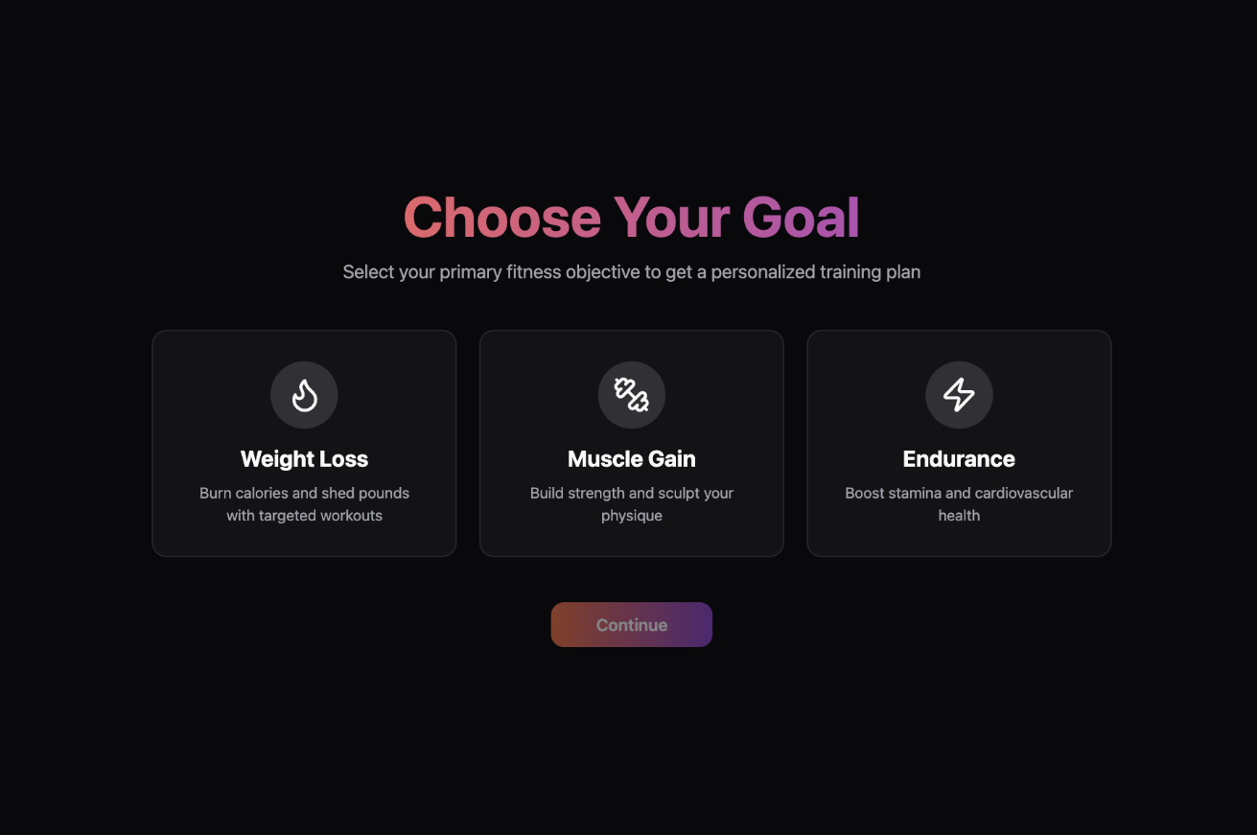
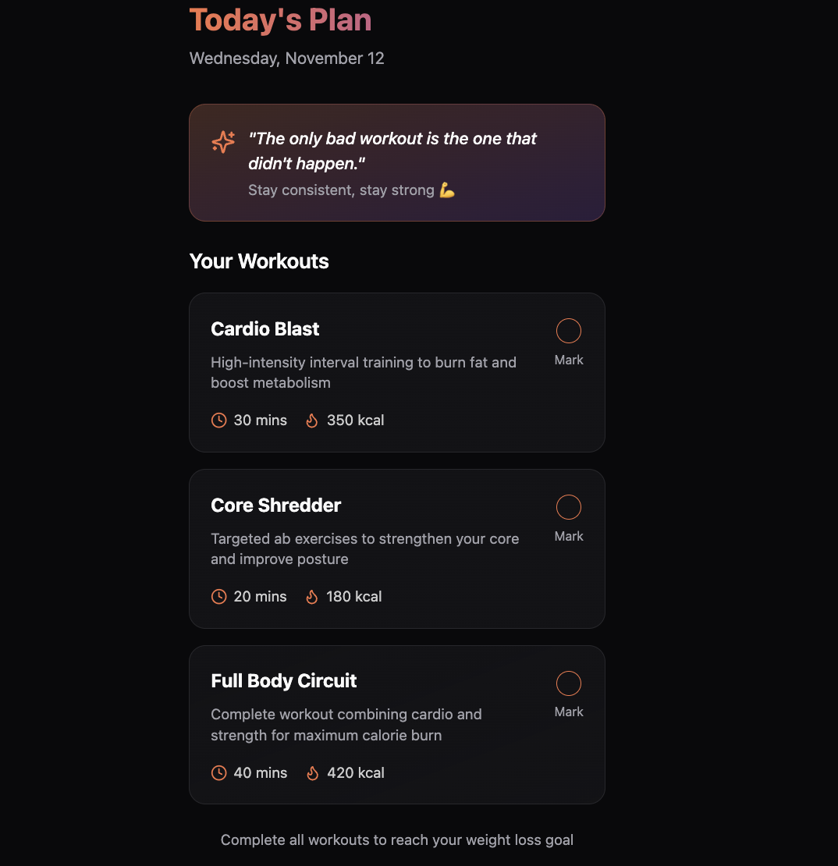
Breakout Group Exercise
LAB EXERCISE OUTCOME
Iteratively Extend Your Prototype Build
Notes:
Notes 📌 Note for Instructors: Briefly give a sneak peak of what students will be building, highlighting that this will be the final outcome of the exercise, and together with students you will walk through the steps together.

Slide 16

Breakout Group Exercise
Steps to follow:
Open your Simplified PRD from Module 3, and as a group, review your Inputs, Outputs, and User Flow to determine a list of 2 or 3 next logical components to prototype.
As a group, decide on one feature to move forward with.
Together, using your own prompt engineering skills, or meta-prompting with a chatbot of choice (ChatGPT, Gemini, etc,) craft your one detailed prompt (keeping FUDI in mind!)
Head to 🔗Lovable and return to your Fitness App goal setting screen project from Module 2.
Paste your new prompt to generate your second feature as part of your prototype.
As a group, compare the new screen to your requirements and identify 1-2 obvious gaps/bugs that require attention. Write them on your doc, but do not fix them yet!
LAB EXERCISE
20 minutes
Iteratively Extend Your Prototype Build
In this hands-on lab, you’ll execute the next BUILD Cycle for your Fitness App. Using your Simplified PRD, you will apply product thinking to expand your prototype into a functional, multi-screen flow.
Your goal is to push your prototype beyond isolated screens by continuously building and connecting the entire core user journey.
✍️ Complete the hands-on lab using the guide here
Notes:
Notes
💥Activity Type: Breakout Group Exercise
✏️Task: Build Your Second Screen
⏱️Time: 20 minutes
📌 Note for instructors: Ensure students return to their original groups from the previous breakout sessions for this module.
This is the first major build lab of M4, connecting the M3 Simplified PRD (PRO) to the build process. The goal is not a perfect prototype; it's to generate a V1 of the next feature and, most importantly, identify the flaws/bugs for the next lab.
Remind students this builds on their M2 'Goal Setting' screen they practiced prompt engineering on, and M3 'Simplified PRD' they built as part of their deliverable.
The critical instruction is DO NOT FIX THE BUGS. They must stop, observe, and write down the 1-2 gaps they find (e.g., "missing back button," "data not formatted").
Be sure to float from room to room after a few minutes to check how students are getting on.
Scenario: In this hands-on lab, students will return to their M3 Simplified PRD and apply their product thinking to build the next logical feature for their Fitness App prototype (the one they started in M2). Their goal is to practice translating their PRD requirements into a detailed prompt, generate the V1 component, and identify its flaws for the next lab/
Instructions:
👉 Make sure students are following along and taking notes in the detailed lab guide.
Instruct students to open their Simplified PRD (from M3) in their groups and review their PRD's inputs, outputs, smart behaviors and user flow to, as a group, decide on the next logical screen or component to build based on the requirements they specced.
Have them craft one detailed prompt for this new feature, reminding them to keep FUDI in mind (they have a guide SOS for those that are stuck).
Instruct one group member to open Lovable, paste the prompt, and generate the V1 component for the new screen.
This is the key step: Instruct students to Analyze (Do Not Fix!). They must compare the new screen to their requirements and write down 1-2 obvious gaps or bugs.
Debrief to follow.
➡️ Reminder: Create Zoom Breakout Rooms

Slide 17
Instructor-Led Q&A
Discuss the following questions
What was the most significant 'bug' or 'gap' your group identified in the second component, and which section of your requirements (e.g., 'User Flow', 'Smart Behaviours') did it relate to?
In this lab, what felt more like the PM 'bottleneck': (A) Deciding what to build (analyzing your document) or (B) Crafting the perfect prompt to get the AI to build it correctly? Explain your reasoning and how you could improve the process.
Q&A DISCUSSION
10 minutes
Iterative BUILD Debrief
Feel free to post your answers in the chat or unmute and share!
You've just put the modular prototyping process into action: breaking down your requirements, building the next key feature as a component, and identifying its initial flaws. This is the core loop for managing complex AI prototype builds.
Notes:
Notes
💥Activity: Instructor-Led Q&A
💬Topic: Iterative BUILD Debrief
⏱️Time: 10 Minutes
You've just put the modular prototyping process into action: breaking down your PRD, building the next key feature as a component, and identifying its initial flaws. This is the core loop for managing complex AI prototype builds. Discuss the following questions:
Questions:
What was the most significant 'bug' or 'gap' your group identified in the second component, and which section of your requirements (e.g., 'User Flow', 'Smart Behaviours') did it relate to?
In this lab, what felt more like the PM 'bottleneck': (A) Deciding what to build (analyzing your document) or (B) Crafting the perfect prompt to get the AI to build it correctly?
Explain your reasoning and how you could improve the process.

Slide 18
Estimated time: 5 minutes
Notes:
Notes
Time for a 5-minute break—you’ve earned it! ☕

Slide 19





Reminder! 🚨
It's always better to see your smiling face! Be present and visible to stay engaged and keep interactions valuable.
Cameras On
Notes:
Notes Here’s a quick reminder to encourage students to turn their cameras on after the break so engagement stays high! No one is perfect, but seeing classmates faces makes the experience better.

Slide 20
Debugging as De-Risking
Notes:
02. Debugging as De-Risking

Slide 21



From “Bug” to “Better Prompt”
The PM’s Debugging Workflow
Debugging an AI prototype is different from traditional code. The "bug" is rarely in the core tool’s code itself, but in your instructions. Your job is to find the instructional flaw:
1
Audit the Requirements (The Source of Truth)
2
Isolate the Prompt's Flaw (The Execution Error)
Notes:
Notes 📌 Note for instructors: Feel free to pause here and storytell your own experience with prototyping bugs. Share an example of a Specification Error (where your original planning/prompting was the mistake) versus a Generation Error (where the AI misunderstood a perfect prompt).
When you're debugging an AI-generated prototype, your primary role is not a developer searching for typos. Your job is a PM debugging your own instructions and logic. The root cause of failure is almost always an instructional flaw (a specification bug, a logic error, or a protocol violation) rather than a bug in the tool's core code.
Therefore, your detective work focuses on finding where the instruction broke down. The fix might involve opening the code (the Glass Box Rule) to target a precise component, but the diagnosis remains instructional. Your detective work focuses on two sources of potential failure: the PRD and the Prompt.
Audit the Requirements (The Source of Truth)
This checks for a Specification Error. We are looking for upstream ambiguity in your Simplified PRD. Did you forget to specify the 'Back' button in your original plan? If your requirements are ambiguous, the AI output will be unpredictable.
Isolate the Prompt's Flaw (The Execution Error)
This checks for a Generation Error. This assumes your requirements were correct, but the execution failed. Look closely at the Prompt that generated the screen. Did you fail to apply a Protocol—for instance, did you forget to use the Naming Protocol on the component? If a protocol was not applied, the resulting system will be unconnected.
Once you diagnose which type of error you have—a Specification Error in the PRD, or a Generation Error in the prompt—you can craft a new, targeted prompt to fix it. This targeted fix is what we call the AI Sandwich, which we will cover next.

Slide 22
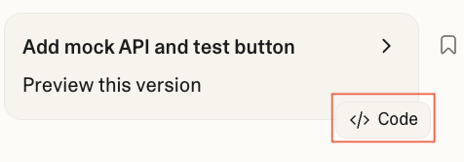
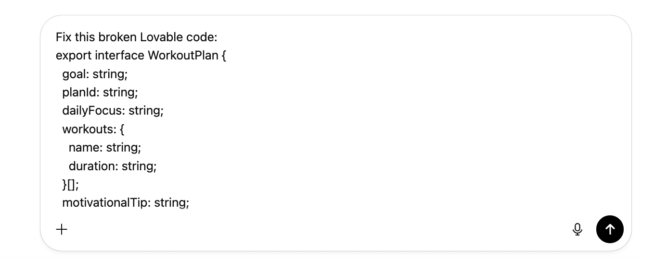
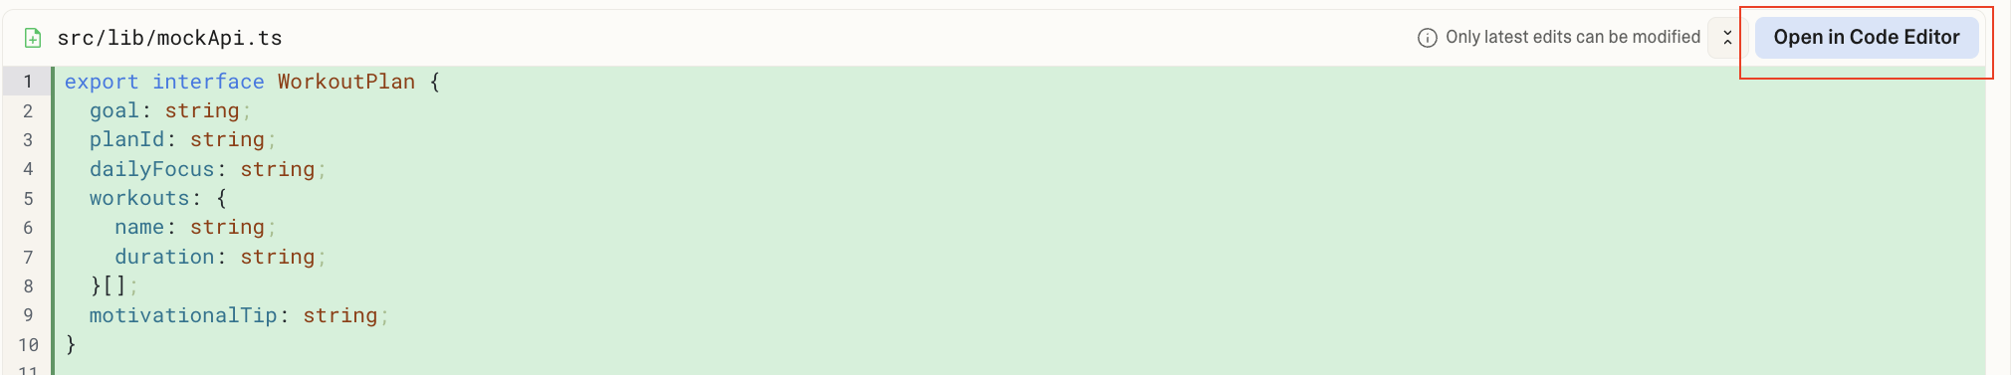
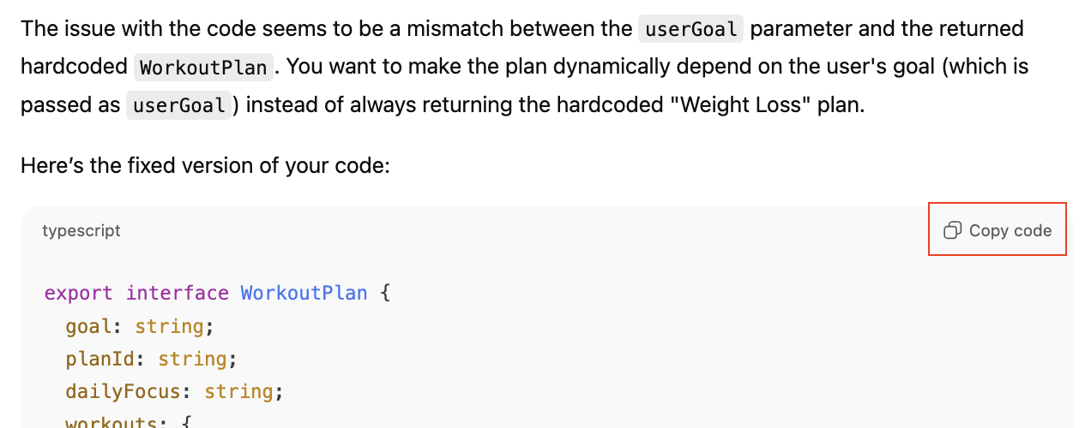
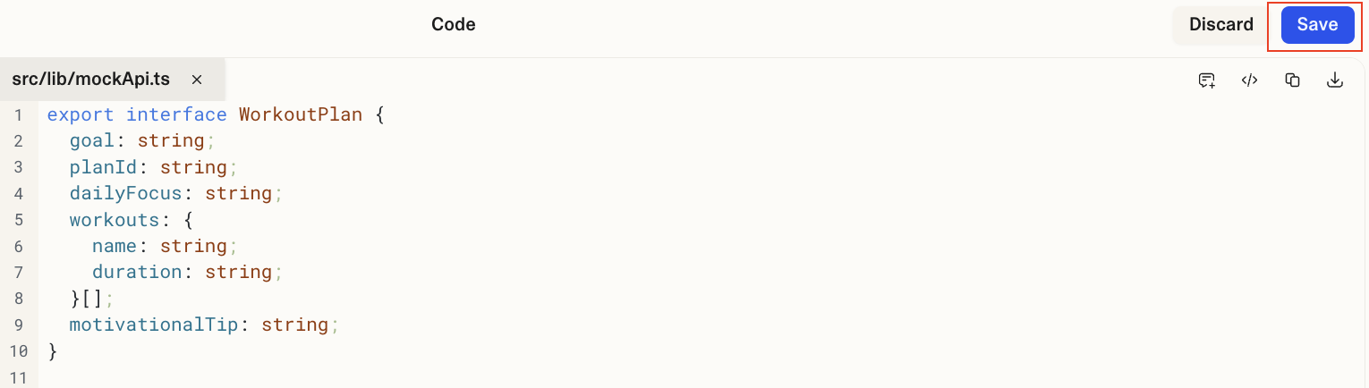
The AI Sandwich Workflow
Code vs. Credits Trade-off
The AI Sandwich is a powerful strategic choice to fix complex bugs without wasting expensive re-prompts on the prototyping AI.
1. Copy Identify the broken component (glass box rule) and copy the entire code block.
2. Fix Paste the code into ChatGPT or Claude and ask for a fix (e.g., "Fix this broken Lovable/React code."
3. Paste Paste the fixed, clean code back into your prototyping tool's code editor and test the repair.
Notes:
Notes
So, you've identified a Critical Logic Error—you have a "Dead Button" or an "Endless Spinner." You know that re-prompting the entire component is the expensive credit trap.
Here is the faster, cheaper workflow to fix the code directly. This is a powerful technique called the "AI Sandwich."
This is the "Code vs. Credits Trade-off"—you are making a strategic choice to save your budget and your time.
AI Sandwich Workflow: This simple, three-step process works - even if you’re not a coder.
Copy: Start by inspecting the code in your prototype output. You don't need to understand or read the code. Just find the broken component and copy the entire code block.
Fix: Paste that broken code into a different AI, like ChatGPT or Claude, and give it a simple prompt like, "Fix this broken React code for my API call." These general-purpose AIs are often better at debugging raw code.
Paste: Take the fixed, clean code from ChatGPT, paste it back into your prototyping tool's code editor, save the change, and test it.
This workflow is often faster, gives you more control, and, most importantly, saves your credits by avoiding expensive, repetitive re-prompts.

Slide 23




Common Failure Zones
Logical Flaws
Broken Components
API Errors
Integration Errors
When the output behavior doesn’t match expectations, the feature delivers inaccurate or unintended results, causing confusion.
When layout divs or event forms don’t render or submit, the user experience is disrupted, and interactions fail to work.
When wrong authentication keys, rate limits, or an incorrect API endpoint address are used, the request fails to reach the destination.
When Supabase or other backend systems don’t sync properly with the frontend, data discrepancies occur, and updates aren’t reflected.
The instructions were flawed. The system works, but delivers the wrong answer.
The code is flawed. A basic element of the view layer is broken.
The front door is flawed. The request cannot enter the backend system.
The internal handshake is flawed. The connection works, but the data agreement/sync fails.
You’ll learn about API and Integration errors coming up in Module 5
Notes:
Notes
So where are the most common failure zones when it comes to figuring out what’s gone wrong in your prototype? Understanding these errors will help you identify issues early and ensure a smoother, more efficient build.
Logical Flaws: Logical flaws happen when the output behavior doesn’t align with the intended functionality. This could involve incorrect calculations, data display, or workflows not following the expected logic.
These flaws lead to inconsistent results.
For example, a user might expect a task prioritization feature to sort tasks by deadline, but the tasks are sorted randomly or by an irrelevant factor instead, which causes confusion and frustration for users.
Broken UI Components: This occurs when UI elements, such as buttons, forms, or interactive components (e.g., divs), are either not rendering or not functioning correctly.
If the UI components fail to load, the user cannot interact with the app as intended.
For example, if a form doesn’t submit, the user’s input is lost, which impacts the overall experience and usability of the product.
API Errors: API errors occur when something goes wrong with the connection between the frontend and backend of your app. This could be due to incorrect authentication keys, missing parameters, or using the wrong API endpoint.
When this happens, the app cannot retrieve or send data correctly, leading to broken functionality.
For instance, if an API call fails to authenticate, the user may not be able to log in or submit data properly.
Integration Errors: Integration errors happen when systems like Supabase (a backend data storage) aren’t properly synced with the frontend of your app. This could involve issues with data fetching or updates not being reflected in real time.
When these errors occur, users may see outdated information or experience data inconsistencies.
For example, if a user updates their profile but the changes aren’t reflected due to an integration error, they may think their updates were lost.

Slide 24

Four Core Debugging Strategies
1
2
3
4
Reflection
Instead of rushing into code fixes, ask AI to first explain or plan the problem space without generating code. This promotes better understanding before patching.
Batching
Instead of overwhelming the AI with the entire prototype at once, target one component or function at a time to isolate issues and prevent cascading errors..
Context Injection Clear, detailed prompts minimize guesswork. Specify which protocols, internal file names, or functions you want analyzed or fixed. Define expected behavior to help AI tailor its diagnosis or solution precisely.
Version Control Avoid broad rewrite requests that cause AI to overwrite large working sections, risking loss of prior work. Use version control or checkpoint features to save progress and focus AI on incremental changes with reflection and batching to keep scope focused.
Notes:
Notes
Even in advanced prototyping, the AI can introduce errors or confusion quickly if you don't impose structure. These four strategies are about managing the process safely, keeping your scope tight, and ensuring your credits are spent efficiently.
Reflection: This is the ultimate PM strategy: Stop generating, and start planning. Before rushing into code fixes, use a prompt to have the AI analyze the problem. Ask it to explain why it thinks the bug occurred, or ask it to list possible solutions before generating a single line of code. This promotes understanding and prevents you from immediately applying the wrong patch.
Batching: This is the strategic answer to preventing cascading errors. Never ask the AI to fix the 'entire prototype.' Handle debugging in small, manageable chunks. Batch your requests by feature or module—target one component or function at a time. This makes the outputs easier to review and isolates issues so one bug doesn't infect the whole system
Context Injection: This is the advanced application of the Naming Protocols we learned earlier. Don't use generic language. You must specify exactly which named elements need modification. Name the files, name the features, and name the protocols. For example, specify: 'Fix the error in the {Dashboard_Route} file involving the {WorkoutCard} component.' This reduces AI guesswork and ensures a precise fix.
Version Control: This is critical for de-risking the final stages of the build. Never issue broad rewrite requests; the AI might overwrite large, working sections of your prototype. Always use checkpoints or internal version control features to save your stable progress. This forces the AI to focus only on incremental changes, protecting your prior investment.
These strategies together can help you debug more efficiently, maintain code quality, and leverage AI safely in the prototyping process.

Slide 25




The AI Debugging Playbook
Use these tactical prompts to leverage the AI as your "co-PM" to diagnose and fix any bugs you’ve identified.
Ask “Why” First "What Are 3 Likely Causes for the navigation error in the {ProfileScreen}?"
Ask the AI to diagnose the problem before you ask for a fix.
Provide Clear Context "The console gave this error: [copy/paste error]. Fix this in the {WorkoutCard} component only."
Give the AI the exact error or flawed output, including internal component names
Fix One by One Let's just fix the navigation bar. Ignore the rest of the page for now.
Use "breakpoints." Isolate the problem and ask the AI to fix one component at a time.
Save Your Work "Copy your last working code/prompt to a text file."
Save your progress before prompting for a major, potentially destructive change.
REFLECTION
CONTEXT INJECTION
BATCHING
VERSION CONTROL
Notes:
Notes
These four strategies are meant to give you a high-level playbook for efficiently debugging your AI-driven prototypes. This is where you apply the strategic mindset
Apply Reflection (Ask "Why?" First): This is the PM's diagnostic step. Instead of rushing to a fix, use the AI to diagnose the root cause. This helps you understand why the system failed—was it a Specification Error or a protocol failure?
Practical Example: Prompt the AI, 'What are 3 likely causes for the navigation error in the {ProfileScreen}?' Or, 'Analyze the code I just generated and explain this error.'
Leverage the AI to identify the problem before you attempt to patch it.
Apply Specificity (Provide Clear Context): Vague prompts get vague (and often wrong) fixes. To ensure a clean repair, you must inject the necessary internal context (the named components and protocols)
Practical Example: Don't just say, 'Fix the button.' Say: 'The {BackButton} doesn't work. Regenerate it, but make sure it links to the {GoalSetting_Route}.'
You are using the named elements to guide the repair.
Apply Batching (Fix One Piece at a Time): Don't try to fix everything at once. This is key to preventing cascading errors. Isolate the problem by targeting one component or function at a time. This simplifies the debugging request for the AI.
Practical Example: Start with: 'Let's just fix the navigation bar. Ignore the rest of the page for now.' Then, move to the next piece: 'Now, let's fix the form submission for the {DailyPlanCard} component.'
Apply Version Control (Save Your Work): Never let a 'fix' destroy your progress. This is your insurance policy. Before prompting for a major change or rewrite, always save your last working version to a text file or checkpoint feature. This gives you a manual 'undo' button if the AI's refinement breaks something else. Your action is simple
Practical Example:
Your Action: Copy your working prompt to a text file before asking the AI to 'try a rewrite' or 'add a complex new feature.'"

Slide 26

Prototyping Bugs Diagnostic Checklist
✍️
Use the 🔗 Debugging Log Template to help keep track of your prototype bugs!
When your prototype is wrong, use this top-down checklist to diagnose the failure. This check helps you understand the type of problem you're dealing with before you decide how to fix it.
Does this bug block the user from completing the core user flow defined in your requirements?
This is your prioritization step. A flow-blocking bug is a P0/P1 issue that needs to be fixed first.
What kind of failure is this?
Is it a logical flaw? A broken component? Categorize and label the symptom using the common failure zones.
Why did this failure happen?
Was it a specification error? Was it a generation error? Locate the source (PRD or prompt).
Next Step
Now that you've diagnosed the bug's priority, type, and root cause, choose the repair method (Re-prompt or AI Sandwich), select the appropriate Debugging Tool, and apply the AI Debugging Playbook to fix it.
Notes:
Notes Note for instructor: Make sure to call out and share the link to the template and show students what it includes (such as the example tab). This template is the direct application of this checklist and will be crucial for their final lab while debugging and iterating on their fitness app.
Before we get into the debugging lab, this is your mental model for advanced debugging. Before you jump in and start writing new prompts to fix things, you must diagnose the problem like a PM. This checklist is a simple, four-step process to find the root cause and prepare your Debugging Log entry. Think about the following:
Priority Check: Does this bug block the core user flow?
This is always your first question. It's about prioritization. Is this a critical, flow-blocking bug (like a broken 'Next' button), or is it a minor visual issue? This tells you if it's a P0/P1 fix-now problem or something you can log for a later iteration.
Failure Classification: What kind of failure is this?
Next, you categorize the symptom using the Common Failure Zones terminology. Is it a Logical Flaw? This means the AI misunderstood your intent (e.g., showing the 'Daily Plan' before the 'Goal Setting' screen). Or is it a Broken Component? This means the UI is visibly broken.
Root Cause Analysis: Why did this failure happen?
This is the most important question: finding the origin. Was it a Specification Error? This is a 'PM bug'—you forgot to ask for the 'Back' button in your PRD or prompt. Was it a Generation Error? This is the 'AI bug'—you did ask for the 'Back' button, but the AI failed to implement it correctly or link it to the wrong page.
Next Step: Once you have these answers (e.g., 'It's a P1 flow-blocker, it's a broken component, and it was a generation error'), then you're ready to apply the Four Core Debugging Strategies and the AI Debugging Playbook (which we just covered) to craft your targeted 'fix-it' prompt. This diagnosis ensures your fix is precise, efficient, and never wastes your credits.

Slide 27




Strategic Debugging Tool Choice
Your Prototyping Tool (Lovable)
Claude Code / Gemini
ChatGPT
Once you have diagnosed the error, your final strategic decision is choosing the right tool for the fix.
For UI/Flow Problems & Simple Fixes When the error is purely visual, a layout adjustment, or a a quick re-run of the last command. Use the prototyping tool to maintain system memory and component names, reducing the risk of design drift.
For Structural Code & Complex Logic Problems For complex functions, fixing broken APIs, or debugging raw React/HTML/CSS blocks copied via the Glass Box Rule. These tools excel at reasoning over code structure—the essential context for the AI Sandwich.
For Abstract Prompting & Conceptual Logic For refining ambiguous natural language and fixing Specification errors by asking it to abstract and plan a solution before coding. ChatGPT excels at instructional problem-solving.
Notes:
Notes
This is the final strategic decision in the debugging process. Once your detective work has identified the error's source—is it a missing component name? A bad API key? A vague prompt?—you need to know which tool to use. This decision is critical to the Code vs. Credits Trade-off.
For UI/Flow Problems and Simple Fixes: Your Prototyping Tool (Lovable): You should only use the main tool for simple fixes and UI adjustments. Why? Because it maintains the system memory. If you're just shifting a button or running the last prompt again, use Lovable to maintain component names and reduce the risk of design drift.
For Code and Logic Problems: Claude Code / Gemini are your specialized debuggers. When you execute the AI Sandwich (the copy-paste workflow) with a complex Code or Logic Problem, send the broken code block here. They excel at reasoning over massive amounts of code, making them perfect for debugging API connections or complex raw functions.
For Prompting & Instruction Problems: ChatGPT: This is your abstract problem solver. If your root cause was a Specification Error (vague requirements or logic), send the prompt here first. It excels at refining ambiguous language, giving you a crystal-clear, improved instruction before you return to the prototyping tool to generate the fix.

Slide 28
Link and Debug Your Prototype Screens
Hands-On Lab
Notes:
Hands-On Lab: Link and Debug Your Prototype Screens

Slide 29
Breakout Group Exercise
Steps to follow:
In your groups, return to you list of gaps or fixes you identified at the end the first hands-on lab, after adding and building your second feature in your Fitness App prototype.
Using the Debugging Log write and plan your fix by identifying the symptom, diagnosing the failure, and determining your debugging strategy.
From your strategy, craft a new, targeted and refined prompt to execute your fix.
Be sure to save your outputs and take screenshots of your update in case you want to use them for your final project deliverable.
If time (and credits) permit, choose a second fix and repeat the process.
LAB EXERCISE
20 minutes
Link and Debug Your Prototype Screens
In this hands-on lab, you’ll return to your fitness prototype from Lab 1 and apply the debugging strategies you just learned to your list your created at the end of the previous lab.
Your goal is to practice the iteration and debugging steps by diagnosing your gaps, planning your fix in the debug log, and using new targeted prompts to fix them in Lovable.
When you’re done, share screenshots of your prototype in Slack so others can see how far you’ve come!
✍️ Complete the hands-on lab using the guide here
Notes:
Notes
💥Activity Type: Hands-On Lab
✏️Task: Link and Debug Your Prototype Screens
⏱️Time: 20 minutes
📌 Note for instructors: Encourage students to share their screenshots in their Slack channel to see the different outputs and ways different groups approached the task!
This is the payoff lab for the debugging section. Students will apply the 4 Core Strategies (Reflection, Batching, Specify, Version Control) to fix the specific bugs they identified in their prototype from Lab 1.
The "Debug Log" is the key artifact they should use to plan their fixes before prompting in Lovable.
Be sure to float from room to room after a few minutes to check how students are getting on.
Scenario: In this hands-on lab, students will return to their prototype (and its list of bugs) from Lab 1 and apply the debugging strategies they just learned. Their goal is to practice the 'Debug' step by diagnosing the bugs, planning their fix in a "Debug Log," and using targeted AI prompts to fix them in Lovable.
Instructions:
Instruct students to open their list of ”to-do” fixes they logged at the end of the first hands-on lab. This is the list of gaps/bugs their group wrote down.
Have students spend 5 minutes filling out the Debug Log template first. They must diagnose their bug(s) and craft the new, targeted "Refinement Prompt(s)" they will use to fix them.
Once their prompt is ready, (either using AI to fix it or not) instruct students to open Lovable and use the Refinement Prompts from their Debug Log to fix the bugs.
IMPORTANT: Remind students to take a screenshot of their final, debugged prototype so they can share on Slack and for their deliverables deck for their project.
Debrief to follow.
➡️ Reminder: Create Zoom Breakout Rooms

Slide 30
Instructor-Led Q&A
Discuss the following questions
What was your group's most successful 'fix'? Briefly share the bug you identified in Lab 1 and the 'fix-it' prompt you used in Lab 2 to solve it.
How many of the bugs your group fixed were 'Specification Errors' vs. 'Generation Errors'
What does this tell you about the importance of the prototyping requirements spec stage?
Q&A DISCUSSION
10 minutes
Link and Debug Debrief
Feel free to post your answers in the chat or unmute and share!
Let's share some great insights. Briefly share the 'before' (the bug) and the 'after' (the fix) screenshots in the Slack channel so we can see your solutions.
Notes:
Notes
💥Activity: Instructor-Led Q&A
💬Topic: Link and Debug Debrief
⏱️Time: 10 Minutes
Let's share some great insights. Briefly share the 'before' (the bug) and the 'after' (the fix) screenshots in the Slack channel so we can see your solutions.
Questions:
What was your group's most successful 'fix'? Briefly share the bug you identified in Lab 1 and the 'fix-it' prompt you used in Lab 2 to solve it.
How many of the bugs your group fixed were 'Specification Errors' vs. 'Generation Errors’ ?
What does this tell you about the importance of the prototyping requirements spec stage?

Slide 31


For our Module 5 lab, one member of your group will need to have OpenAI billing credits.
Billing credits are required for API connections and to make API calls. If you do not have credits, you cannot complete the API integration exercise for your prototype. The account must have $5.00 minimum credit to work. Head to OpenAI Billing and review your details.
If your group does not have one member with a Lovable Pro account, one member will also need to sign up for a free Supabase account for the manual integration to work.
Please ensure both steps have been completed before Module 5 class begins.
Tool Reminder
Notes:
Notes
📌 Note for instructors: Please urge students to click the link and sign up for Lovable by the end of class today. They will need an account for all upcoming exercises and labs. While we ensure that the exercises can be completed with the 5 daily credits on the free tier, we strongly encourage students to upgrade to the Pro account in order to get the full prototyping experience.

Slide 32
Key Takeaways
Build, Iterate and Debug Prototypes End-to-End
The 5-step build process (Break Down, Unpack, Iterate, Link, Debug) provides a structured system to move from spec to prototype. This playbook helps PMs manage the AI prototyping cycle by breaking down complexity and ensuring prototypes are well-constructed.
Debugging is about de-risking and refining requirements, not just fixing bugs. By diagnosing gaps, PMs ensure their prototypes are thoughtful and their requirements are clear.
A Debug Log can help PMs translate a bug diagnosis into an actionable 'fix-it' prompt. This ensures PMs apply debugging strategies systematically to iterate and improve the prototype.
Notes:
Notes
At the end of each module, recap key concepts and content covered in today’s lesson.

Slide 33
Power Advanced Prototypes With API Integrations
Extra Practice
Optional: Dig deeper into your hands-on lab experiences and try these exercises on your own.
1. Link and Debug Your Full Fitness App Flow
Choose an additional feature and build the next part of your Fitness App. HINT: You can use your screenshots to set up the prompt so you don’t start from zero and can replicate it easily!
2. Prototype a Feature from Your Own Job
Think about a product at your own company. Using the strategies and methods you’ve learned from Modules 1-3, build your own prototype to show at your next 1:1.
⏩ Next Session
Overview
Learn to integrate live APIs to connect your prototype to real-world data and advanced AI capabilities.
Apply a security-first mindset to API integrations, focusing on safe key management, data privacy, and compliance-aware access patterns.
Notes:
Notes
📌 Note: that the “Dig Deeper” section is optional for students who want to get additional practice with more advanced topics or explore further on their own time.
Next Session: Give a brief overview of what students can expect during the next session.

Slide 34

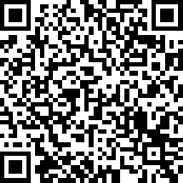
Share here
Your Opinion Matters To Us
We’d love to hear about your experience!
At the end of each session, please scan the QR code or use the link to share your feedback.
Your insights help us improve and make each cohort better than the last.
🔗 https://www.surveymonkey.com/r/MFMW7DF
Notes:
Notes
We will be having daily surveys at the end of each class, and your opinion matters to us.
This is crucial in making sure our team can learn the best way to support you, and if we are also hitting the mark, Like real product managers, we would want to iterate and adjust so that we can support your needs.

Slide 35


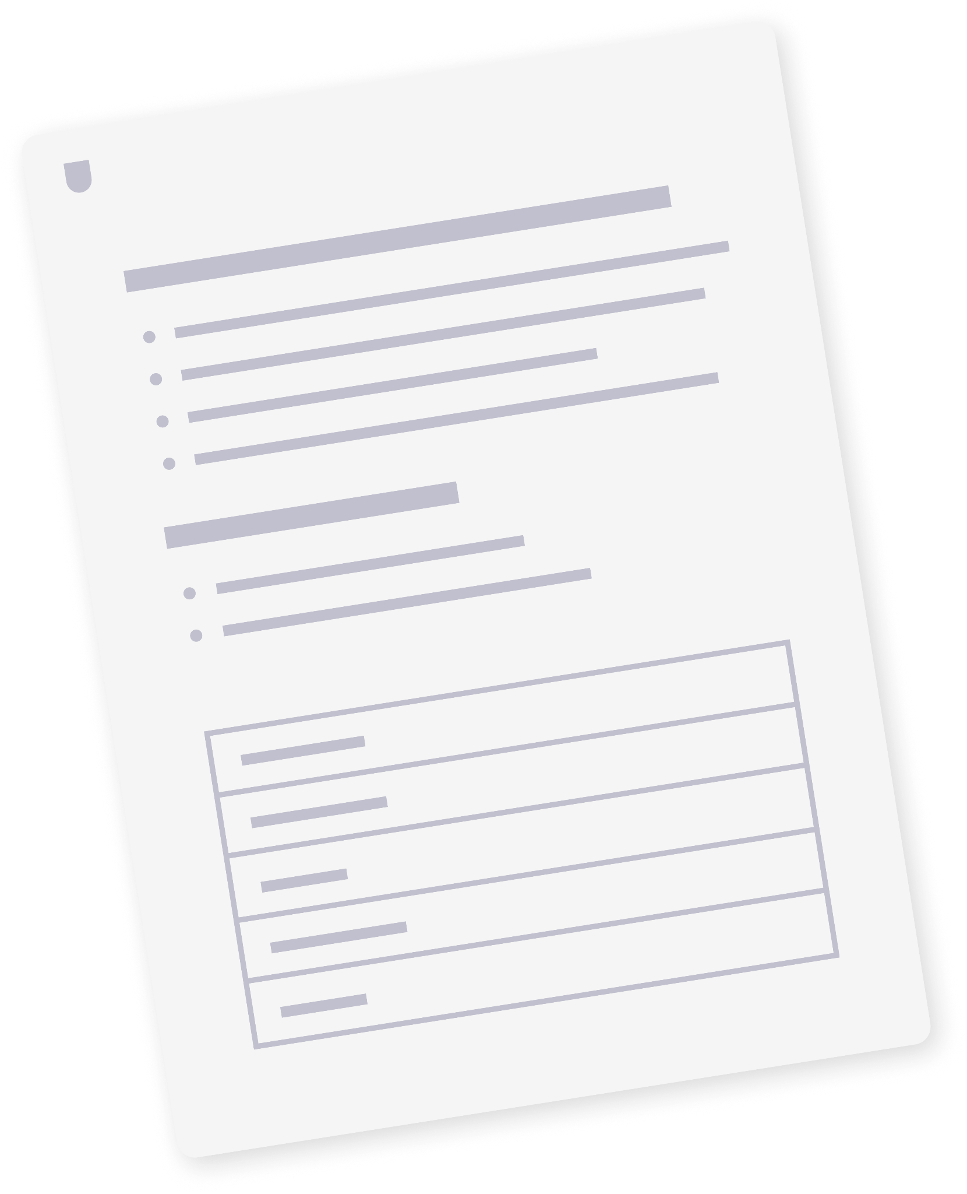
Resources & Templates
HANDS-ON LAB WALKTHROUGH
PRODUCT SCHOOL TEMPLATE
Module 4 Lab Guide
Debugging Log Template
View resource
View template
Notes:
🗂 Resources
Here are resources students can leverage to deepen their knowledge of what we have covered in this class, as well as all materials used for activities.

Slide 36
Q&A
Notes:
Notes
💥Activity: Q&A
This is a chance to dive deeper into the topics covered and answer any additional questions students may have!

Slide 37
Notes:
Thank you 💥

